Slide 1
UDL Core Foundation Resource
Learn about the UDL Knowledge Statement:
There are opportunities for flexible assessment options.

Slide 2
Universal Design for Learning
Universal Design for Learning (UDL) is a research-based framework that can be used to anticipate human variability and to reduce learning barriers in the design of any environment. The UDL Guidelines are a tool for applying UDL to practice.
Knowledge Statements
The UDL Knowledge Statements (KS) were developed as part of the UDL credential initiative by Learning Designed. Together with the UDL Guidelines, these KS can be used to reflect on how the design of any learning experience anticipates variability and reduces barriers.

Slide 3
First… a brief overview of the UDL Knowledge Statements.

Slide 4
Overview: UDL Knowledge Statements
The UDL Knowledge Statements (KS) were developed as part of the UDL credential initiative by CAST and the UDL-IRN.
Together with the UDL Guidelines, these KS can be used to reflect on how the design of a learning experience anticipates variability and reduces barriers in any context.

Slide 5
The UDL Knowledge Statements
Goals
The goal is presented so that learners can perceive and understand it.
The goal is separate from means, where possible.
The goal is presented to highlight its relevance.
The goal promotes expert learning by encouraging challenging ways of thinking and doing.
Assessments
There are opportunities for flexible assessment options.
Materials & Methods
Flexible methods are available for learners.
Flexible materials are available for learners.

Slide 6
Now... a focus in on one of the UDL Knowledge Statements.

Slide 7
Assessments: UDL Knowledge Statement
Goals
The goal is presented so that learners can perceive and understand it.
The goal is separate from means, where possible.
The goal is presented to highlight its relevance.
The goal promotes expert learning by encouraging challenging ways of thinking and doing.
Assessments
There are opportunities for flexible assessment options.
Materials & Methods
Flexible methods are available for learners.
Flexible materials are available for learners.

Slide 8
Why is having opportunities for flexible assessment options important?
We know that there will be variability in how learners can best demonstrate their skills and knowledge. A “one-size-fits-all” assessment is not going to accurately measure what learners understand and can do.
To gain a better understanding of what learners know, can do, and care about, offer flexible assessment options. These can be embedded into ongoing, formative assessments, as well as summative assessments such as end-of-unit tests.

Slide 9
What does it mean to offer flexible assessment options?
UDL provides a framework to anticipate learner variability and design assessments with flexible options.
From UDL Theory and Practice: “To get the most accurate data about what students understand and can do, assessments should not offer only one means of response but should provide multiple opportunities in varied media for learners to demonstrate skills and express themselves.”

Slide 10
How can I offer flexible assessment options?
First, identify the goal, or the key construct, you want to measure.
Then, separate the means, or how, from the goal.
For example, imagine a lesson goal is for students to understand the stages of cell division by building a model.
If the goal is about understanding, flexible assessments could be to write, draw, or build a model.
If the goal is to build a model, flexible assessments could be the materials they use or how they can collaborate.

Slide 11
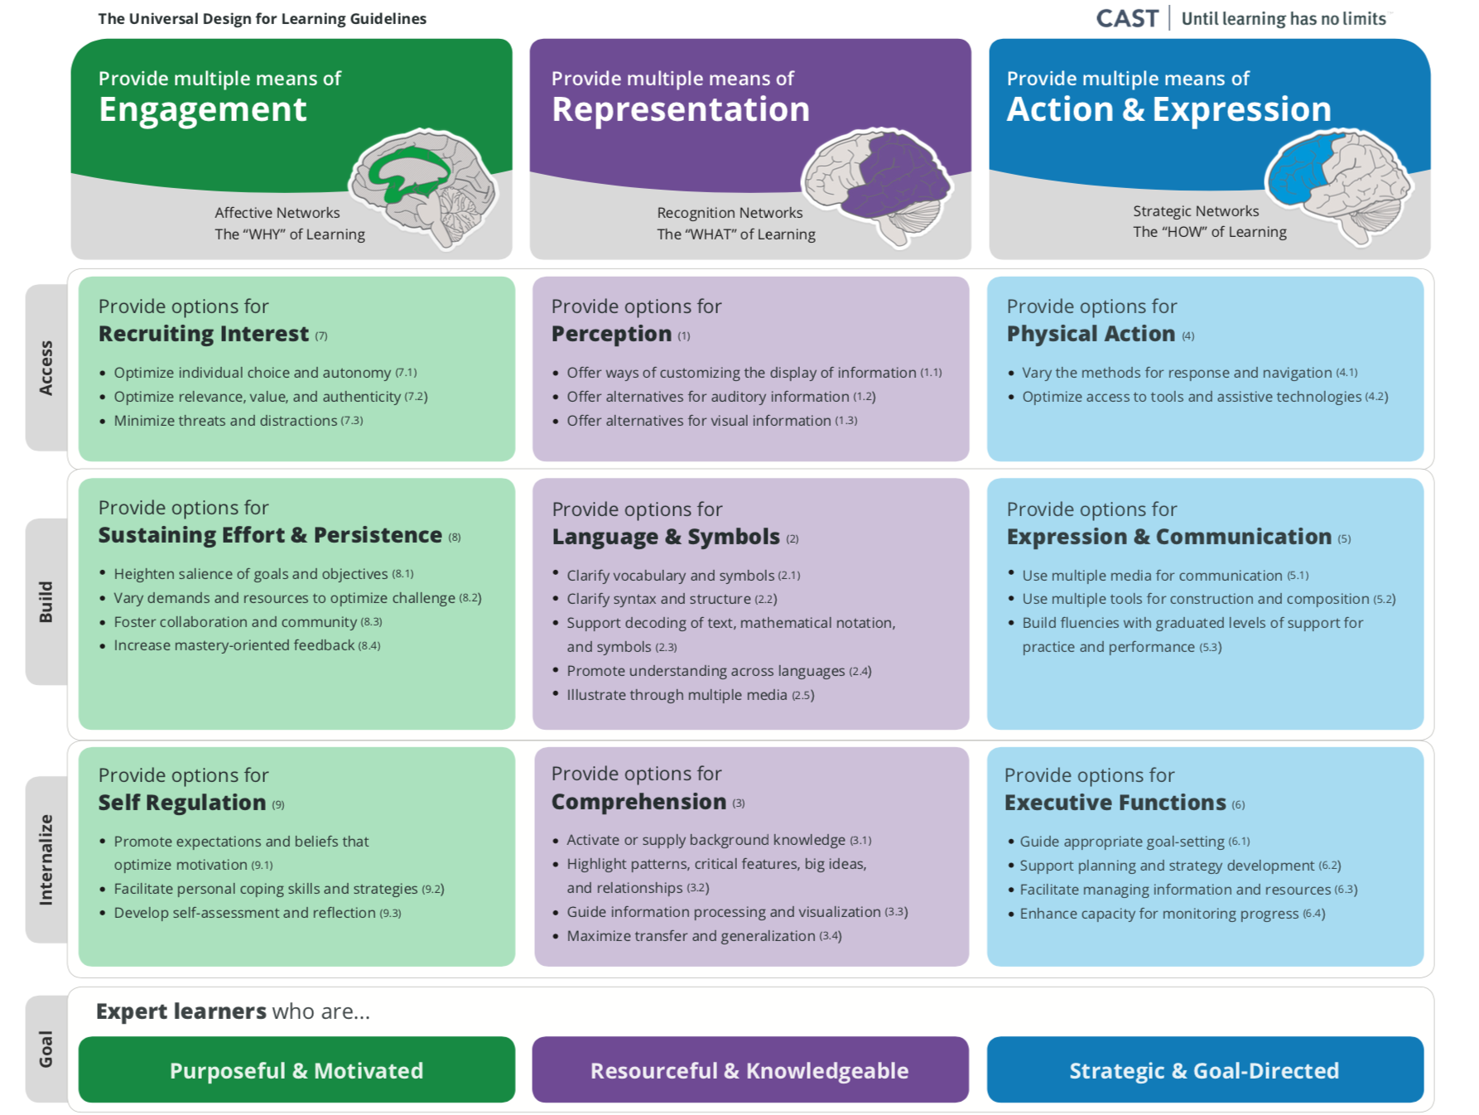
Use CAST’s UDL Guidelines
Use the UDL Guidelines to design flexible assessment options that anticipate variability and reduce barriers.
Turn any of the UDL Guidelines and checkpoints into questions to ask about your assessment. For example,
how is the assessment relevant?
how are there options for students to perceive the assessment?
how are there options for students to show what they know?
Make sure your assessment aligns to the construct you want to measure!

Slide 12
What is an example of how an educator offered flexible assessment options?
While there is no one way to offer flexible assessment options, here is how one educator provided flexible assessment options in a lesson:
Students could write, draw, or record their answers.
Students received formative feedback during the learning experience.
Students had a self-reflection checklist to help them assess their own progress.

Slide 13
Frequently Asked Question #1 about UDL Assessments:
What if students always choose the “easy” assessment option?
Educators often wonder if students will choose the “easy” option when flexible assessments are offered. Here are some points to consider:
If the goal is challenging, there should not be an “easy” option.
Remember variability: support students to select the option that allows them to best demonstrate what they know and can do.
Remember cognitive load: sometimes choosing a familiar way to show what you know can “free up” cognitive energy to focus on more challenging aspects of the learning.

Slide 14
Frequently Asked Question #2 about UDL Assessments:
How can I prepare students for tests that do not offer flexible assessment options?
Sometimes learners must demonstrate understanding in one way.
If students have been able to learn the content through multiple means of engagement, representation, and action and expression, they will have gained access to numerous ways to explore and make meaning of the content. This prepares them to demonstrate this rich learning on a test.
You can also support students to learn about the structure of a test, this will help them to be prepared.

Slide 15
References
CAST (2018). Universal Design for Learning Guidelines version 2.2. Retrieved from http://udlguidelines.cast.org
Meyer, A., Rose, D. H., & Gordon, D. T. (2014). Universal design for learning: Theory and practice. CAST Professional Publishing.

