Slide 1
UDL Core Foundation Resource
Learn about a UDL Knowledge Statement:
Flexible materials are available for learners.

Slide 2
Universal Design for Learning
Universal Design for Learning (UDL) is a research-based framework that can be used to anticipate human variability and to reduce learning barriers in the design of any environment. The UDL Guidelines are a tool for applying UDL to practice.
Knowledge Statements
The UDL Knowledge Statements (KS) were developed as part of the UDL credential initiative by Learning Designed. Together with the UDL Guidelines, these KS can be used to reflect on how the design of any learning experience anticipates variability and reduces barriers.

Slide 3
First… a brief overview of the UDL Knowledge Statements.

Slide 4
UDL Knowledge Statements
Goals
The goal is presented so that learners can perceive and understand it.
The goal is separate from means, where possible.
The goal is presented to highlight its relevance.
The goal promotes expert learning by encouraging challenging ways of thinking and doing.
Assessments
There are opportunities for flexible assessment options.
Materials & Methods
Flexible methods are available for learners.
Flexible materials are available for learners.

Slide 5
Now... a focus in on one of the UDL Knowledge Statements.

Slide 6
Materials and Methods
Goals
The goal is presented so that learners can perceive and understand it.
The goal is separate from means, where possible.
The goal is presented to highlight its relevance.
The goal promotes expert learning by encouraging challenging ways of thinking and doing.
Assessments
There are opportunities for flexible assessment options.
Materials & Methods
Flexible methods are available for learners.
Flexible materials are available for learners.

Slide 7
Flexible materials
Goals
The goal is presented so that learners can perceive and understand it.
The goal is separate from means, where possible.
The goal is presented to highlight its relevance.
The goal promotes expert learning by encouraging challenging ways of thinking and doing.
Assessments
There are opportunities for flexible assessment options.
Materials & Methods
Flexible methods are available for learners.
Flexible materials are available for learners.

Slide 8
What are
materials?
Materials include the media and tools that are used to share information with learners. They also can be used by learners to deepen understanding or to show what they know.
Materials could include digital technologies, such as a hyperlinked glossary or online video tool, or they could be “low tech” options such as a whiteboard or math manipulatives.

Slide 9
What is unique about “UDL” materials?
UDL materials are varied, flexible, and provide different pathways for learners to progress toward the goal.
UDL helps inform the selection of materials, which is not about finding the “right” material for a learner. Instead, it is about aligning flexible materials with the intended learning goal and ensuring that all can access and use the materials, as needed, from the start of a learning experience.

Slide 10
Why is having flexible materials so important?
Learners will vary in how they perceive, act on, or engage with materials. There will be a range in the materials each individual needs to access, build skills, and develop expert learning in each experience.
To address this variability, the UDL framework suggests offering flexible materials that align to the learning goals.

Slide 11
Consider this example:
In a 5th grade lesson, the goal is for students to learn the stages of butterfly metamorphosis. Students can read from a print textbook or a digital textbook or watch a captioned video.
What are the flexible materials available in this example?
See the next slide for a response to this question!

Slide 12
Response
In a 5th grade lesson, the goal is for students to learn the stages of butterfly metamorphosis. Students can read from a print textbook or a digital textbook or watch a captioned video.
What are the flexible materials available in this example?
Response: The flexible materials include the print and digital textbook, where learners can read or listen to the content. The flexible materials also include the captioned video, which has flexible audio and caption options to access the content.

Slide 13
Consider learner variability & barriers:
In a 5th grade lesson, the goal is for students to learn the stages of butterfly metamorphosis. Students can read from a print textbook or a digital textbook or watch a captioned video.
How do these flexible materials support learner variability and reduce barriers?
See the next slide for a response to this question!

Slide 14
Response:
In a 5th grade lesson, the goal is for students to learn the stages of butterfly metamorphosis. Students can read from a print textbook or a digital textbook or watch a captioned video.
How do these flexible materials support learner variability and reduce barriers?
Response: There is variability in how learners perceive the information. Some students will prefer visual representations in the text or video. Others will prefer to listen to the digital text or to the video to learn.
Having the flexible materials anticipates this variability in perception and reduces barriers by having flexible ways that students can perceive the necessary background information.

Slide 15
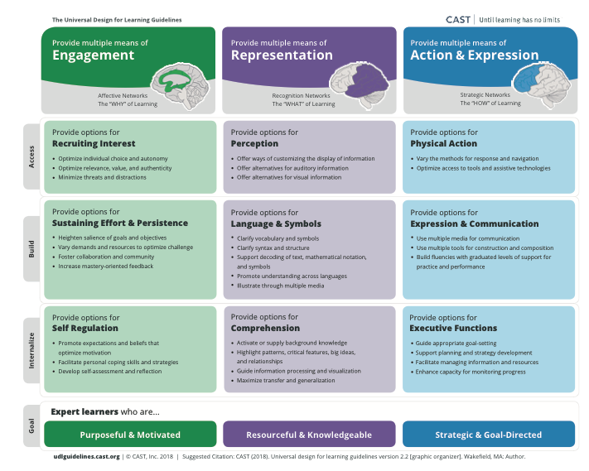
Use the UDL Guidelines to reflect on how you can provide flexible materials in your learning experience to support learner variability and reduce barriers in the learning environment.
The flexible materials can help reduce barriers in Engagement, Representation, and/or Action & Expression.

Slide 16
References
CAST (2018). Universal Design for Learning Guidelines version 2.2. Retrieved from http://udlguidelines.cast.org
Meyer, A., Rose, D.H., & Gordon, D.T. (2014). Universal design for learning: Theory and practice, CAST Professional Publishing.

